Slide 1
OpenGL visibility culling
Advanced Graphics Programming

Slide 2
Backface culling

Slide 3
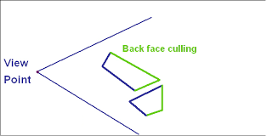
What is backface culling?
Is the ability of the GPU to cull faces that are not oriented towards the camera.

Slide 4
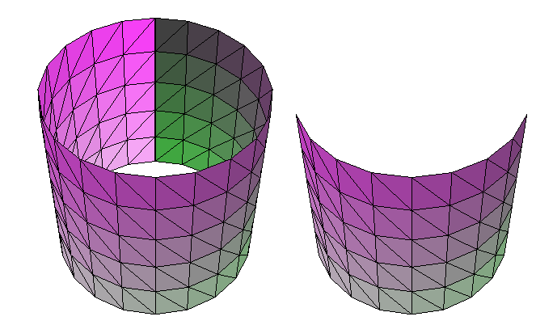
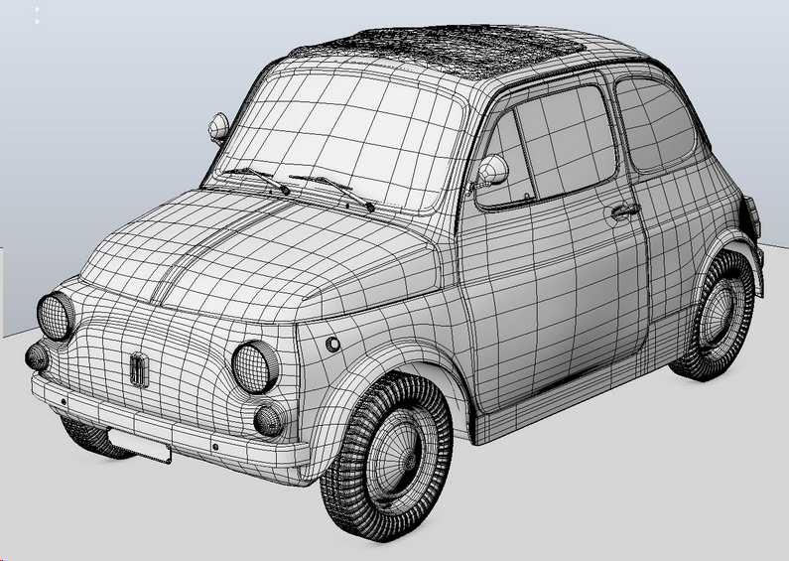
What is backface culling?
Is the ability of the GPU to cull faces that are not oriented towards the camera.
Without backface culling
With backface culling
Usually, the models we work with are well closed, so we could never see culled backfaces

Slide 5
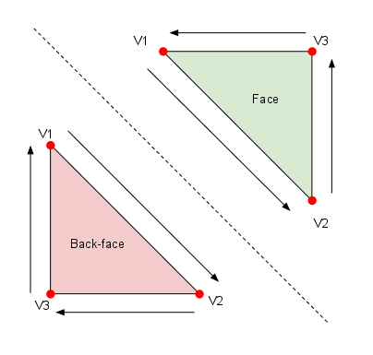
How does OpenGL determine front / back?
With the winding order of triangles. By default, clockwise orientation of vertices determines back faces. Otherwise, if a triangle follows a counter-clockwise order of vertices as seen from the camera, it is a front face.
Counter clockwise
Clockwise

Slide 6
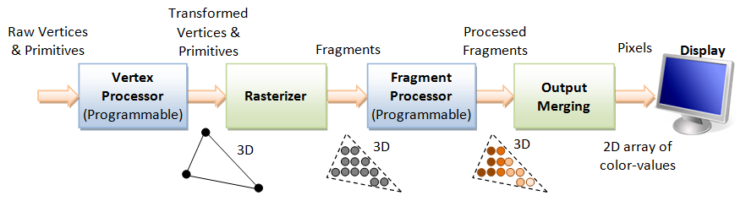
Backface culling in the rendering pipeline
It happens after vertex have been transform, before rasterizing any fragments.
Face culling

Slide 7
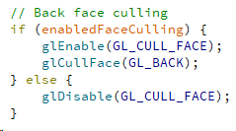
OpenGL calls
We can modify the state of face culling in OpenGL with the following calls:
Enables face culling
Will cull only back faces
Disables face culling

Slide 8
Depth testing

Slide 9
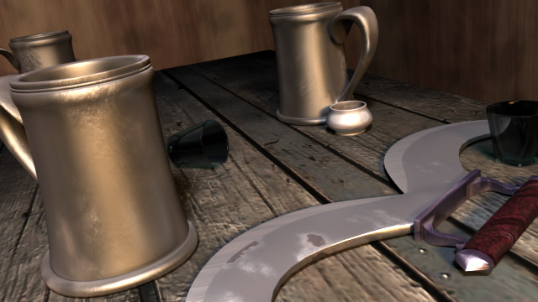
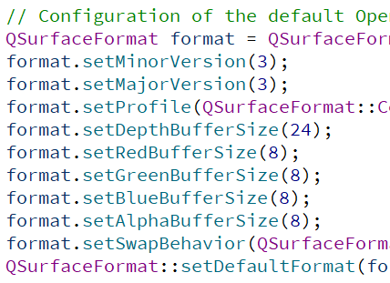
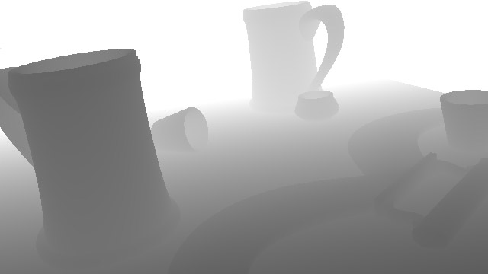
What are depth buffers? (also z-buffers)
It is a surface that stores depth information (instead of color or alpha…)
Depth buffer
Color buffer (RGB)

Slide 10
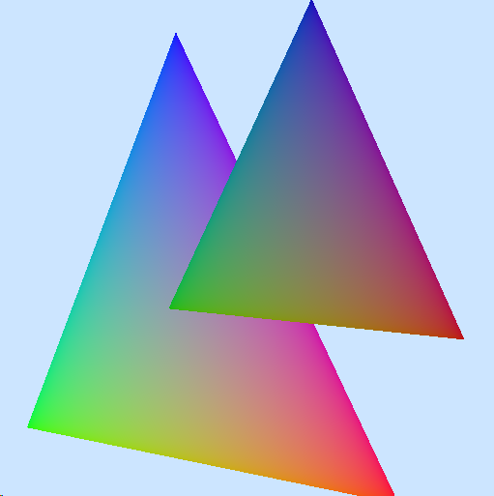
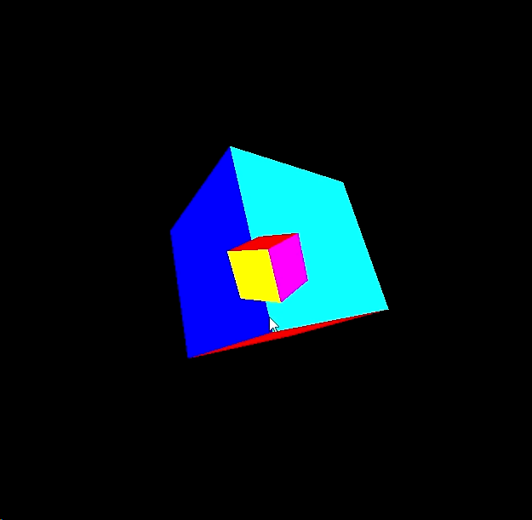
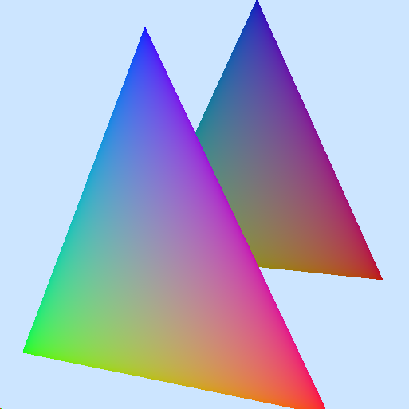
What is a depth buffer used for?
The depth buffer is used to avoid rendering geometry that is supposedly occluded in front of its occluder objects...
Without depth testing
In this example, the small cube is actually farther from the camera than the big cube.
However, the big cube is rendered first, and the small (farthest) cube is rendered last.
This happens if the depth testing is disabled...
With depth testing

Slide 11
Depth testing in the rendering pipeline
Depth testing is a per-fragment operation that usually takes place here:
Depth test
Write to Z buffer

Slide 12
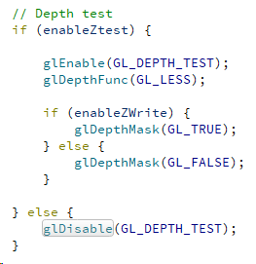

OpenGL calls
We can modify the state of depth testing in OpenGL with the following calls:
Sets the clear depth value to 1
GL_LESS: Only fragments nearer to the camera will be processed
Enables depth writing
Disables depth writing
Clears the color (to blue) and the depth buffer (to 1)

